Slide 1
CIS117 Week 10
Grep and friends

Slide 2
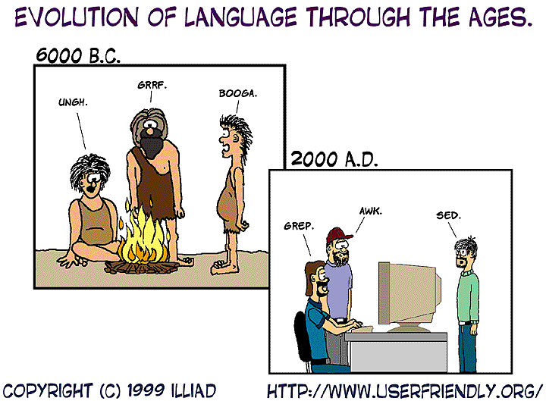
grep
grep is a command to filter lines that contain specific text
Can be used alone or part of a chain
Examples
  cat /etc/passwd
  cat /etc/passwd | grep Jane
  cat /etc/passwd | grep Jane |wc –l
  cat /etc/passwd | grep –v Jane
https://english.stackexchange.com/questions/186811/deriving-a-word-for-the-activity-of-using-a-tool-from-the-tool-name-grep/186817

Slide 3
Redirect and append
Redirect >
Append >>
What's the difference?
DEMO > and >>

Slide 4
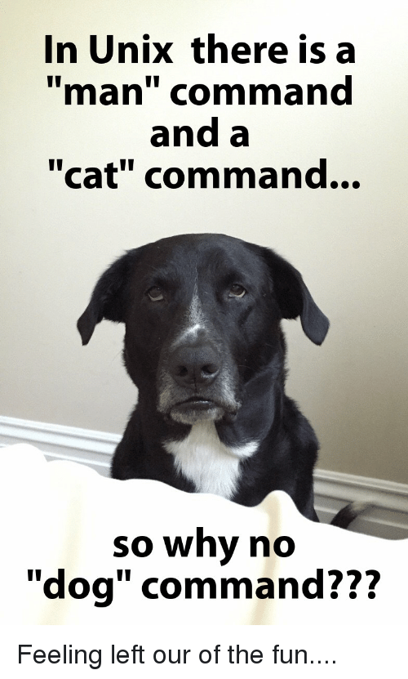
Display file options
cat Used to display a file
Alternatives head, tail and od
  head displays top (default 10) lines
  tail displays end (defaults to 10) lines
  od displays any file by showing hex code
https://me.me/i/in-unix-there-is-a-man-command-and-a-cat-1108000

Slide 5
File comparison
Use diff to compare files
By default the output is designed to be read by computer not human
diff can be integrated into other things
  Git
  Emacs

Slide 6
Tar
What is a tarball?
  Means tape archive
Why are the used?
  To archive files, so they can be easily moved around and worked with
How do you use one?
  tar –cvf ~/name.tar /home/user/directory
Gzip is also used to compress into a gzip instead of archive. To use add z to the options (-cvzf) also change the extension to .tar.gz or .tgz

